Slide 1
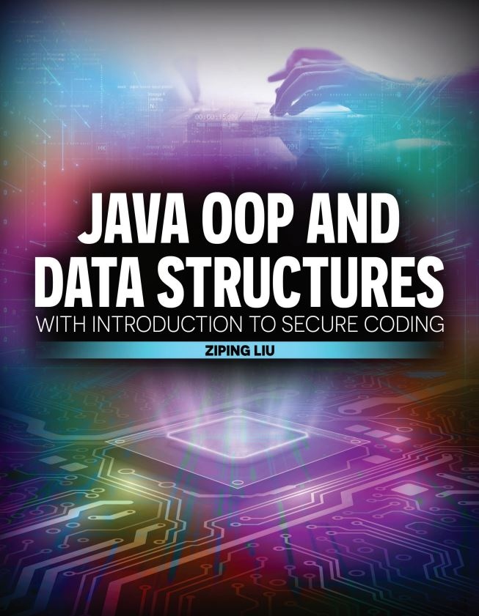

Slide 2

Java OOP and Data Structures with Introduction to Secure Coding Dr. Ziping Liu
Chapter 6 Inheritance: Additional Topics

Slide 3
https://he.kendallhunt.com/product/java-oop-and-data-structures-introduction-secure-coding
Chapter 6 Inheritance: Additional Topics

Slide 4

Chapter Outlines
Using packages in your programs
Limiting accessibility and extensibility with the package-private modifier
Practicing secure coding with inheritance relationships:
Using subclass overriding
Declaring final methods and classes
Distinguishing between immutability and final
Compiling and running Java programs from command line (available on the supplemental website)
Defining and using Java Enums (available on the supplemental website)
More on Java Secure Coding Guidelines

Slide 5
6.1 Packages
packages are a great way to organize related classes and other relevant files
We have been using packages whenever we import one of the Java libraries
java.lang is a Java package which contains classes and interfaces that are fundamental to the design of the Java programming language. You can think of java as a top-level folder and lang as a subfolder beneath that. Some of the classes in java.lang include: String, StringBuilder, System, Integer, and Double

Slide 6
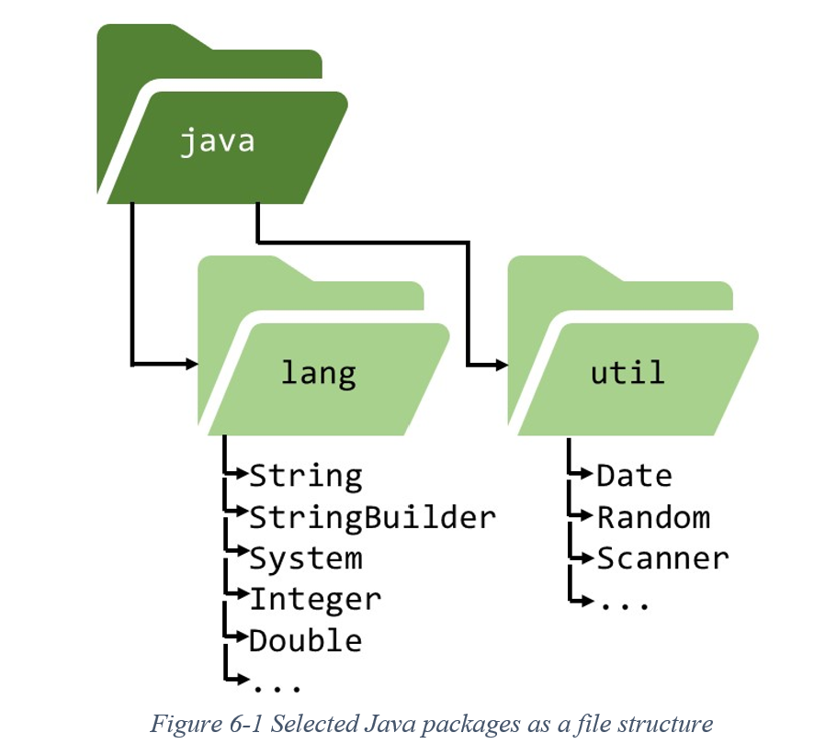
6.1 Packages
the complete list of all Java packages on the official Java documentation website: https://docs.oracle.com/javase/8/docs/api/

Slide 7
6.2 Secure Coding Guideline: Make Package-Private to Preserve Encapsulation
If a variable or method does not have any visibility modifiers, Java treats it as package-private
Package-private visibility grants access to any class that is a part of the same package, regardless of whether that class is a subclass

Slide 8
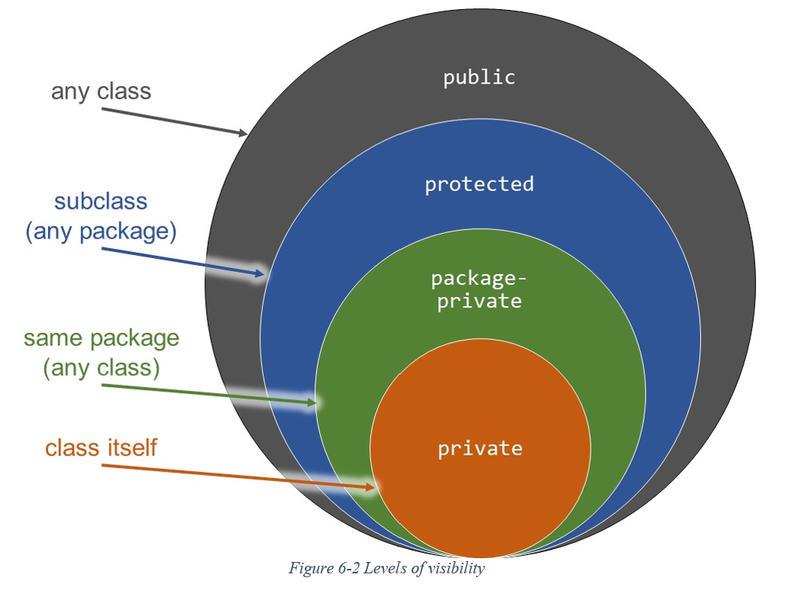
6.2 Secure Coding Guideline: Make Package-Private to Preserve Encapsulation

Slide 9
6.2 Secure Coding Guideline: Make Package-Private to Preserve Encapsulation
Information Hiding with Package-Private
declare items as private or package-private to achieve the objective of information hiding in OOP when those items are only to be used internally
If a class will be published for external users, declare the class as public. Otherwise, declare the class as package-private for your own (“internal”) use.
Within a class, declare as public or protected those variables and methods that will be part of a published API. Declare non-API variables and methods as private or package-private for your own (“internal”) use.

Slide 10
6.2 Secure Coding Guideline: Make Package-Private to Preserve Encapsulation
Using public Features in the Client Driver

Slide 11
6.3 Secure Coding Guideline: Override to Prevent Security Holes
changes to a superclass can cause unwanted or unexpected behavior in subclasses if the classes are not carefully designed
A key secure coding recommendation is that we must override methods from a superclass if the subclass has a particular security need

Slide 12
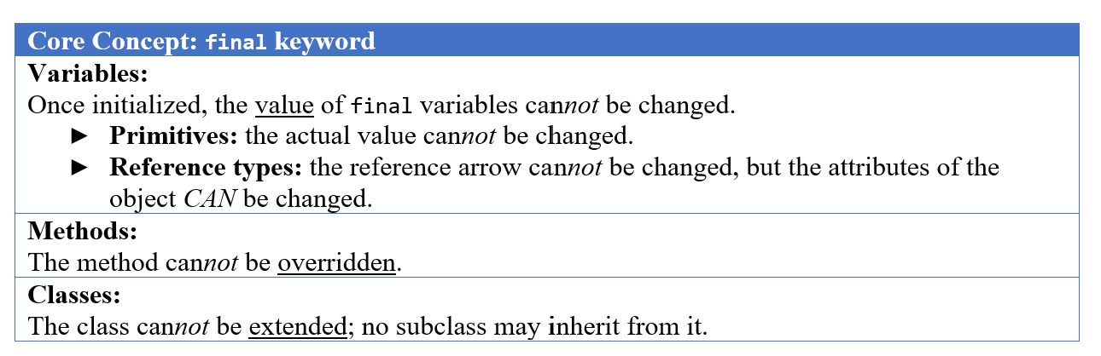
6.4 final Methods and Classes
Secure Coding Guideline: Declare final Methods and Classes

Slide 13
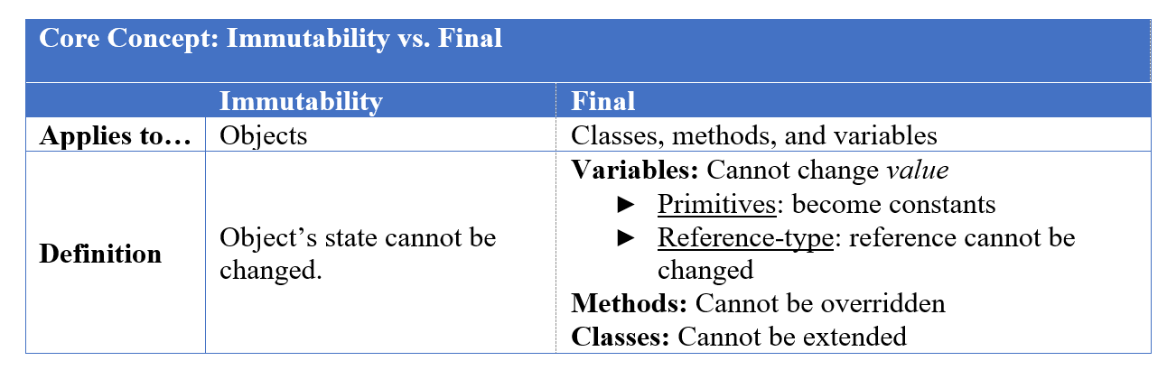
6.4 final Methods and Classes

Slide 14


Slide 15


Slide 16
Which National Park is it?
Answer: Petrified Forest National Park

